Slide 1

The lecture 1
Introduction to python
Vladislav Karyukin

Slide 2

Why Python?
1) Open source
2) Syntax as simple as English
3) A large, active, collaborative community
4) Extensive packages for almost any task
print('Hello, World!')
python
public class Hello{
public static void main(String argv[]){
system.out.println('Hello, World!');
}
}
java
#include <stdio.h>
int main(){
printf('Hello, World!');
return 0;
}
C language

Slide 3
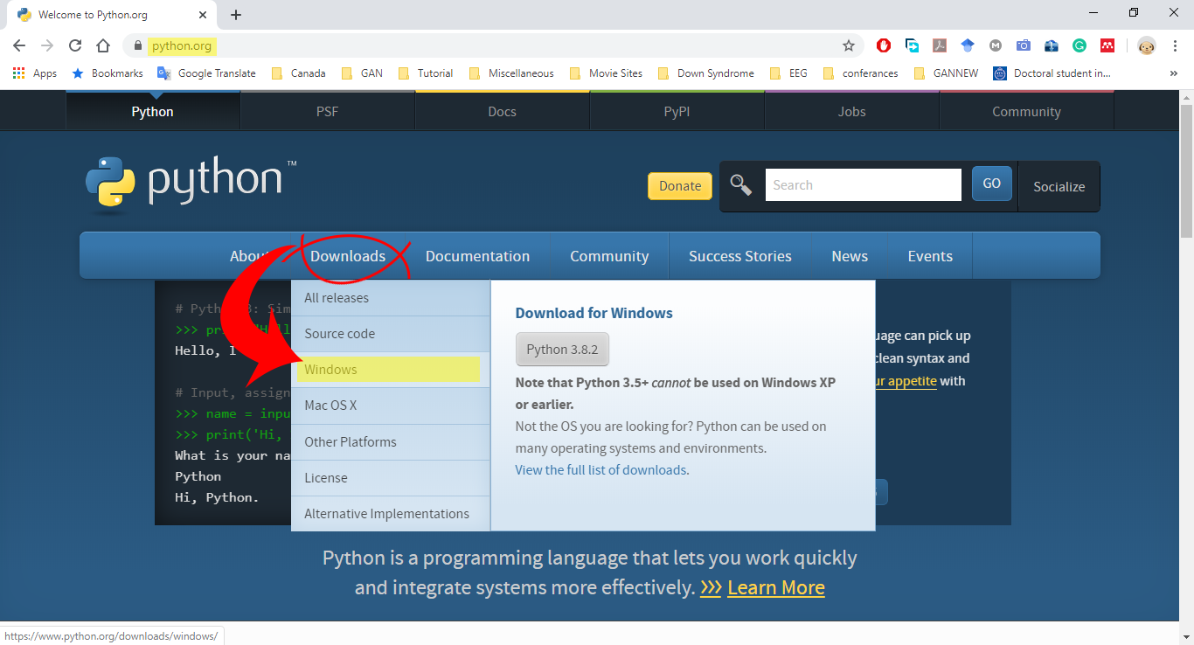
Installing Python
Windows users
python.org
Step 1: Select Version of Python to Install
Windows

Slide 4
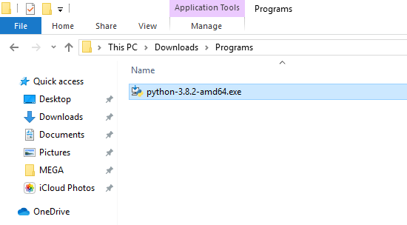
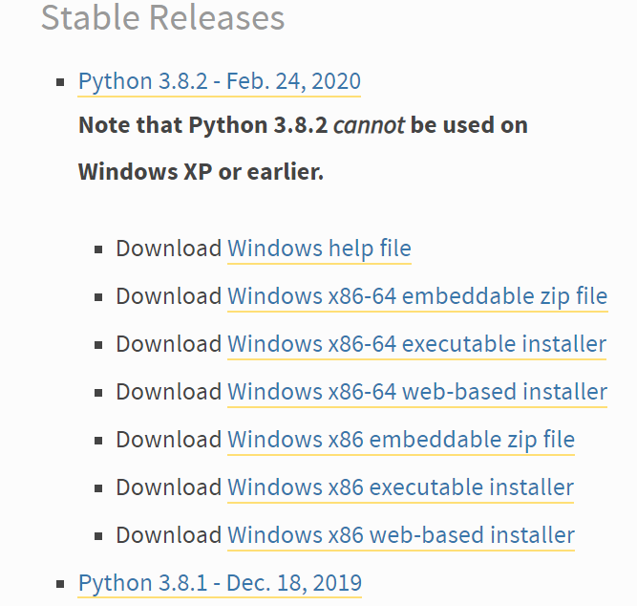
Installing Python
Windows users
Step 1: Select version of Python to install
Step 2: Download Python executable installer

Slide 5
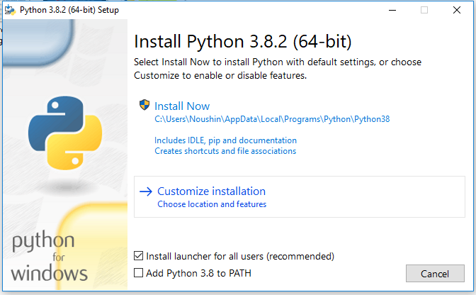
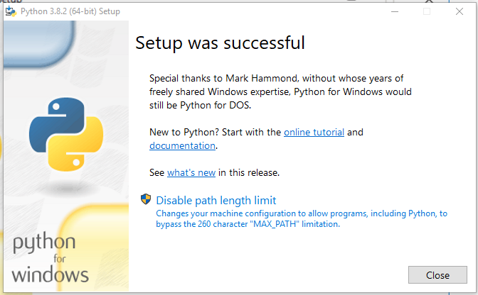
Installing Python
Windows users
Step 1: Select version of Python to install
Step 2: Download Python executable installer
Step 3: Run executable installer
2
1

Slide 6
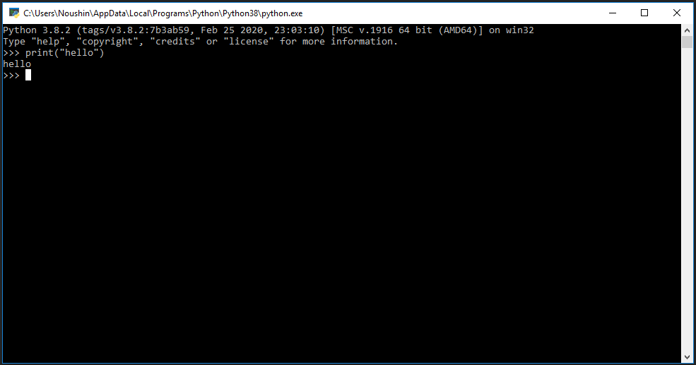
Installing Python
Windows users
Step 1: Select version of Python to install
Step 2: Download Python executable installer
Step 3: Run executable installer
Step 4: Verify Python is installed successfully
C:\Users\Username\AppData\Local\Programs\Python\Python38
Python prompt
Interactive mode -> Command line Interactive(CLI)

Slide 7
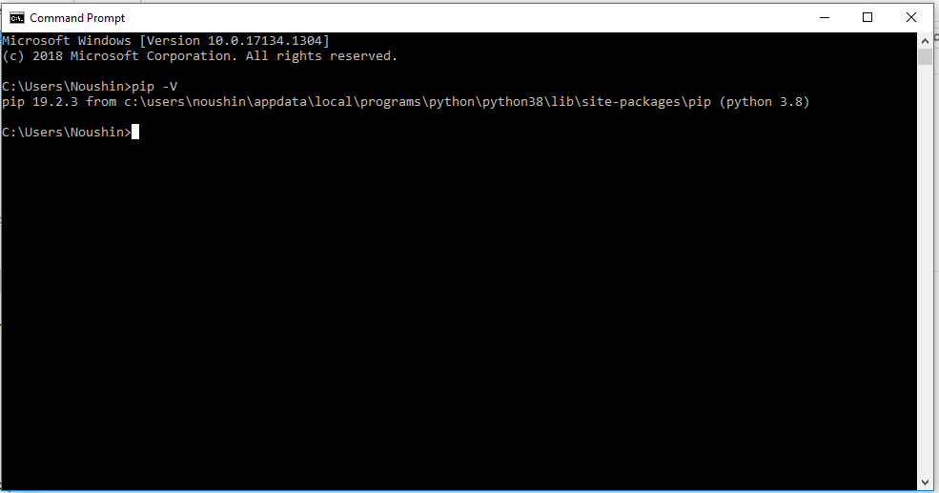
Installing Python
Windows users
Step 1: Select version of Python to install
Step 2: Download Python executable installer
Step 3: Run executable installer
Step 4: Verify Python is installed successfully
Step 5: Verify pip is installed
Open 'Start' menu and type 'cmd'
pip -V

Slide 8



Python IDE
Integrated Development Environment (Text Editor)
PyCharm
Eclipse
Spyder

Slide 9
Variables and Data Types
memory
A variable is a unit of data with an identifier, which is held in your computer's memory;
There are two stages to creating a variable, the first is to create the container and stick an identifying label on it: this is called initialization. The second is to put a value into it: this is called assignment.
age
35
initialization
variable = value
Notes:
The data your software will be manipulating will take various forms; these values are assigned to
things called variables, which you can think of as a box that contains a single piece of
information, often a word or a number. The important thing is that the information in the box can be changed by
putting a new value into it;

Slide 10
Variables and Data Types
Variable names must begin with either a letter or an underscore.
Note: they can contain numbers, they must not start with one
strings
integers
floating points
booleans
'''
Problem: Define different data types.
Target Users: Noushin Hajarolasvadi
Target System: GNU/Linux
Interface: Pycharm
Functional Requirements: None.
User must be able to initialize and assign variables.
'''
information = None
number = 0 # number is an integer variable
roll_width = 1.4 /* roll_width is a floating point variable */
price_per_metre = 5
filename = 'data.txt'
trace = False
sentence = 'this is a whole lot of nothing'
total_price = roll_width * price_per_metre
dynamic typing

Slide 11
Variables and Data Types
Once Python has decided what type a variable is, it will flag up a TypeError if you try to perform an inappropriate operation on that data.
'''
Problem: Try to add different data types.
Target Users: Noushin Hajarolasvadi
Target System: GNU/Linux
Interface: Pycharm
Functional Requirements: None.
User must be able to initialize and assign variables.
'''
b = 3
c = 'word'
trace = False
d = b + c
Traceback (most recent call last):
File '<stdin>', line 1, in <module>
TypeError: unsupported operand type(s) for +: 'int' and 'str'

Slide 12
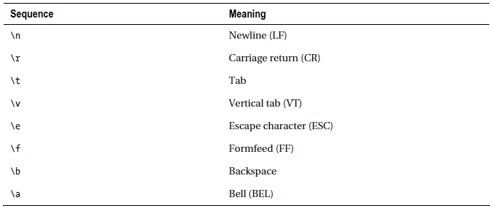
First Program
Hello World
Get a value from the user and display it.
'''
Problem: Get a value from the user and display it.
Target User: Noushin Hajarolasvadi
Interface: Pycharm
'''
name = input('Enter your name: ')
print('Your name is:', name)
print('and it has\t', len(name), '\t charachters')

Slide 13
Operators
Symbol | Operation
** | exponent
% | modolus
// | integer division
/ | division
* | multiplication
- | subtraction
+ | addition
'''
Problem: try differentoperators.
Target Users: Noushin Hajarolasvadi
Interface: Pycharm
'''
a = 9
b = 10.5
print('sum is:', a + b)
print('difference is:', a - b)
print('multiplciation is:', a * b)
print('division is:', a / b)
print('power is:', a ** b)
print(a > b)
Symbol | Operation
>, < | exponent
>=, <= | modolus
== | integer division
!= | division

Slide 14
Operators
Logical operators:
(expression1) and (expression2)
(expression1) or (expression2)
not (expression2)
'''
Problem: apply all logical operators.
Target Users: Noushin Hajarolasvadi
Target System: GNU/Linux
Interface: Pycharm
'''
a = 2
b = 8
c = 4
d = 6
print((a >= b) and (c < d))
print((a >= b) or (c < d))
print(not a)
false
true
false
true
false

Slide 15
Control Structures
Get the name of the user and if his/her name is Alice, display the message 'Hi, Alice'. Otherwise, show the 'Hello, stranger. ' message
    if(expression1) :
    statement
    else:
    statement
'''
Problem: control the structure of the program by selection.
Target Users: Noushin Hajarolasvadi
Target System: GNU/Linux
Interface: Pycharm
‘‘’
name = input('Enter your name: ')
if name == 'Alice':
print('Hi, Alice. ')
else:
print('Hello, stranger.')
indentation

Slide 16
Control Structures
Showing different messages to the user based on his/her age. Just a simple example.
    if(expression1) :
    statement
    elif(expression2):
    statement
    else:
    statement
'''
Problem: control structure of the program.
Target Users: Noushin Hajarolasvadi
Target System: GNU/Linux
Interface: Pycharm
'''
age = input('Enter your age: ')
if age == 20:
print('Not old, not young!')
elif age < 20:
print('You are young.')
else:
print('Oh, you are old.')

Slide 17
Control Structures
Create the sequence of numbers between 0 and 1000 and display it to the user.
    for i in sequence:
    statement
'''
Problem: control structure of the program by iteration.
Target Users: Noushin Hajarolasvadi
Target System: GNU/Linux
Interface: Pycharm
'''
for i in range(1000):
print(i)
range
range(a)
range(a, b, c)
range(a, b)
0
...
a-1
a
...
b-1
a
...
b-1
+c
+c
+c
+1
+1
+1
+1
+c
+1
+1
+1
+1

Slide 18
Homework
Implement a program that gets work hours of 10 employees and calculates the salaries for one month based on the following table:
work hour | Coeff. | salary per hour ($)
40 hours | 1 | 70
> 40 | 1.25 | 90
< 40 | .9 | 70

Slide 19
Thank you for attention

